Slide 1


Ensemble Method
Sai Sathvick Chirakala
Graduate Student
February 18, 2020

Slide 2
WHAT ARE THEY ?
Ensemble methods is a machine learning technique that combines several base models in order to produce one optimal predictive model.

Slide 3
EXPLANATION – DECISION TREE (EXAMPLE)
A Decision Tree determines the predictive value based on series of questions and conditions.
For instance, this simple Decision Tree determining on whether an individual should play outside or not.
The tree takes several weather factors into account and given each factor either makes a decision or asks another question.

Slide 4
EXPLANATION – CONTINUED
In this example, every time it is overcast, we will play outside.
However, if it is raining, we must ask if it is windy or not? If windy, we will not play.
But given no wind, tie those shoelaces tight because were going outside to play.

Slide 5
Explanation
Ensemble Methods allow us to take a sample of Decision Trees into account, calculate which features to use or questions to ask at each split, and make a final predictor based on the aggregated results of the sampled Decision Trees.

Slide 6
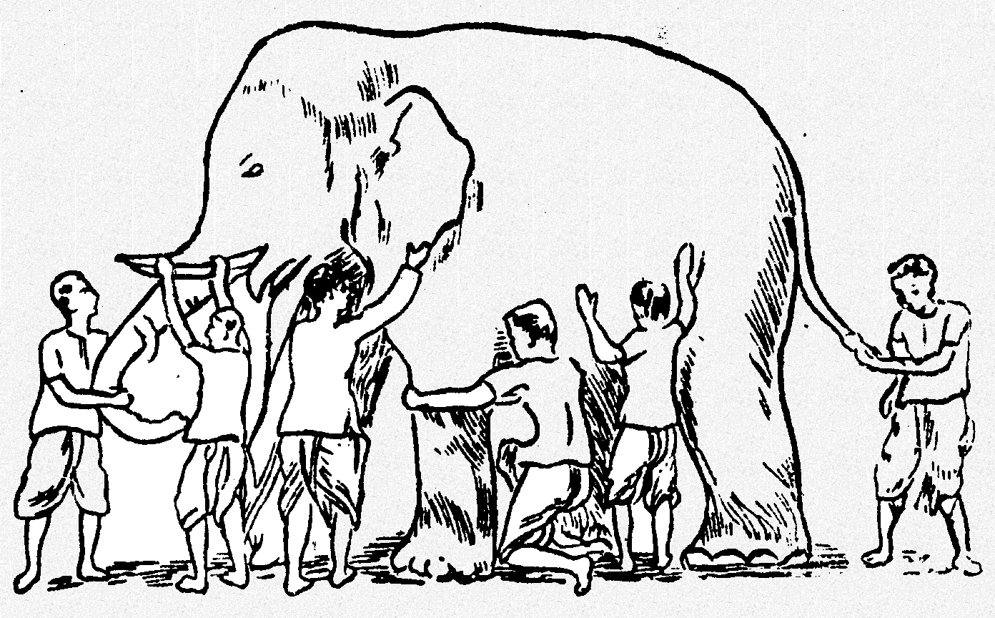
Why Ensemble Works?
Some unknown distribution
Model 1
Model 6
Model 3
Model 5
Model 2
Model 4
Ensemble gives the global picture!
6

Slide 7
Types of Ensemble Methods
BAGGing or Bootstrap AGGregating
BAGGing gets its name because it combines Bootstrapping and Aggregation to form one ensemble model.
Given a sample of data, multiple bootstrapped subsamples are pulled.
A Decision Tree is formed on each of the bootstrapped subsamples.
After each subsample Decision Tree has been formed, an algorithm is used to aggregate over the Decision Trees to form the most efficient predictor.

Slide 8
BAGGing or Bootstrap AGGregating

Slide 9
Types of Ensemble Methods
Random Forest Models
Random Forest Models can be thought of as BAGGing, with a slight tweak.
When deciding where to split and how to make decisions, BAGGed Decision Trees have the full disposal of features to choose from.
Although the bootstrapped samples may be slightly different, the data is largely going to break off at the same features throughout each model.

Slide 10
Random Forest Models
Decides where to split based on a random selection of features.
Implements a level of differentiation because each tree will split based on different features.
This level of differentiation provides a greater ensemble to aggregate over, thus producing a more accurate predictor.

Slide 11
Random Forest Models

Slide 12
SUMMARY
The goal of any machine learning problem is to find a single model that will best predict our wanted outcome.
Ensemble methods take a myriad of models into account and average those models to produce one final model.
It is important to note that Decision Trees are not the only form of ensemble methods

Slide 13


